Slide 1
Estate Planning for Loved Ones with Mental Health and/or Substance Use Disorders
February 13, 2025
8:30 AM – 10:00 AM

Slide 2
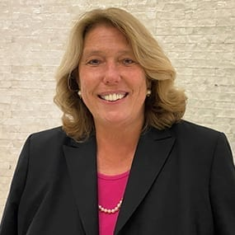
Panelists
Patricia C. Marcin, Esq.
Rivkin Radler LLP
Steven Chassman, LCSW, CASAC
LICADD
Jamie A. Rosen, Esq.
Meister Seelig & Fein PLLC

Slide 3
Opening Remarks
Patricia C. Marcin, Esq.
Partner, Tax, Trusts & Estates
Rivkin Radler LLP
926 RXR Plaza
Uniondale, NY 11556
(516) 357-3342
Patricia.Marcin@rivkin.com

Slide 4
Role of a Trusted Advisor
If we don’t have these difficult conversation with clients, who will?
Notes:
Patricia –

Slide 5
ESTATE PLANNING FOR PEOPLE IMPACTED BY MENTAL HEALTH CONDITIONS
STEVE CHASSMAN, LCSW, CASAC
Executive Director
Notes:
Steve

Slide 6
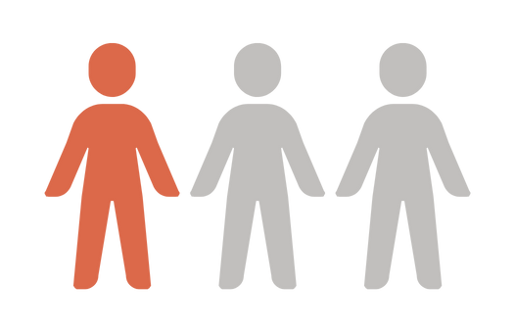
Mental Health Conditions
According to SAMHSA, among U.S. adults 18+ in 2023:
An estimated 1 in 3 adults (aged 18+) had a mental health OR substance use disorder.
(SAMHSA, 2024)
Notes:
Among adults aged 18 or older in 2023, 32.8 percent
(or 84.5 million people) had either AMI or an SUD in
the past year

Slide 7
Mental Health Conditions
Most Common Mental Health Conditions:
Anxiety disorders
Depressive disorders
Post-traumatic stress disorder
Mood disorders (e.g. Bipolar Disorder)
Borderline Personality Disorder
Eating disorders (Binge Eating Disorder)
(SAMHSA, 2024)
Notes:
Among adults aged 18 or older in 2023, 32.8 percent
(or 84.5 million people) had either AMI or an SUD in
the past year
https://www.usa.edu/blog/mental-health-statistics/#:~:text=clinical%20mental%20illness.-,Mental%20Health%20Statistics%20by%20Type,States%20are%20various%20anxiety%20disorders.&text=Approximately%2019.1%25%20of%20adults%20have,disorder%20within%20the%20last%20year.&text=Anxiety%20disorders%20come%20in%20many,mental%20illness%20is%20major%20depression.&text=In%202021%2C%2021%20million%20adults,of%20the%20U.S.%20adult%20population.&text=They%20also%20found%20that%20there's,Anxiety%20disorders:%2019.1%25&text=Major%20depression:%208.3%25&text=Post%2Dtraumatic%20stress%20disorder%20(PTSD,Bipolar%20disorder:%202.8%25&text=Borderline%20personality%20disorder%20(BPD):%201.4%25&text=Binge%20eating%20disorder:%201.2%25&text=Obsessive%2Dcompulsive%20disorder%20(OCD):%201.2%25&text=Schizophrenia:%200.25%20%2D0.64%25

Slide 8
Substance Related and Addictive Disorders (DSM-5-TR)
Per the DSM-5-TR, substance use disorder is used to describe the wide range of the disorder, from a mild form to a severe state of chronically relapsing, compulsive pattern of drug taking.
Substance-related disorders also includes gambling disorder.
Notes:
Addiction is a process & progression.
The earlier in life a person starts drinking, smoking, or using other substances, the worse their addiction is likely to become.

Slide 9
Substance Related and Addictive Disorders (DSM-5-TR)
According to SAMHSA. in the U.S. among people 12+ in 2023:
Notes:
Addiction is a process & progression.
The earlier in life a person starts drinking, smoking, or using other substances, the worse their addiction is likely to become.

Slide 10
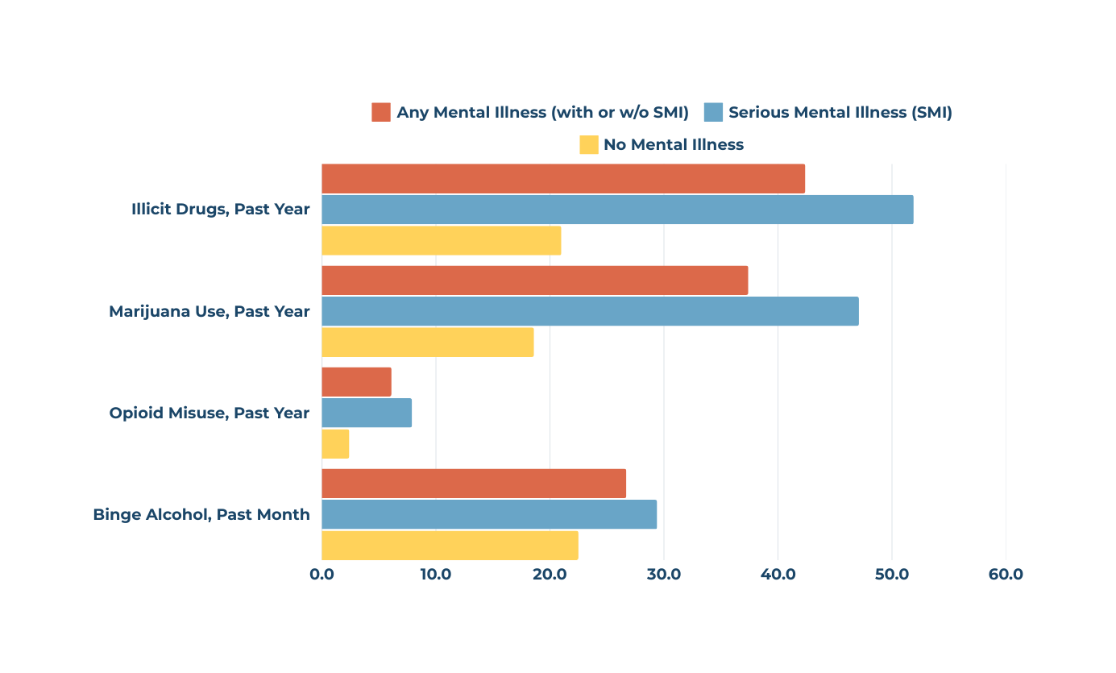
Co-Occurring Disorders
According to SAMHSA, in 2023:
Nearly one-third of adults (aged 18+) in the United States (U.S.) had a co-occurring mental health disorder & SUD.
(Hammond, 2017; Partnership to End Addiction, 2019; Walter et al., 2020; SAMHSA, 2024)
Notes:
For example: a person who has depression might use alcohol daily in an attempt to feel happier, however in reality they’re not happier but are temporarily blunting the sadness they feel.

Slide 11
Co-Occurring Disorders
A co-morbid disorder is when two or more disorders are occurring at the same time in the same person.
Common co-occurring SUD and mental disorders:
Anxiety disorders
Depressive disorders
Mood disorders
Eating disorders
Post-traumatic stress disorder
(Hammond, 2017; Partnership to End Addiction, 2019; Walter et al., 2020; SAMHSA, 2024)
Notes:
For example: a person who has depression might use alcohol daily in an attempt to feel happier, however in reality they’re not happier but are temporarily blunting the sadness they feel.

Slide 12
LICADD Programs and Resources
Stay Connected With Us!
www.licadd.org
(516) 747-2606
(631) 979-1700

Slide 13
Jamie A. Rosen, Esq.
Partner, Chair, Mental Health Law Group
Meister Seelig & Fein PLLC
100 Jericho Quadrangle, Suite 208, Jericho, NY 11753
125 Park Avenue, 7th Floor, New York, NY 10017
(646) 539-3705
jr@msf-law.com
Notes:
Jamie

Slide 14
Serious Mental Illness
Diagnoses
Symptoms
Stigma and Misinformation
Obstacles
Lack of insight
Access to care
Cost of care

Slide 15
Mental Health of a Beneficiary/Fiduciary
Why is mental illness and/or substance use disorder relevant to an estate planning conversation with a client?
Mental health of a beneficiary
Potential disqualification from receiving public assistance
Frivolous spending, waste, mismanagement
Mental health of a fiduciary
Capacity to serve as a fiduciary under HCP/POA/Will/Trust

Slide 16
Sample Questions
Neutral, non-judgmental
Patience
Compassion
Open-ended questions

Slide 17
Red Flags
What are the signs that someone might not be capable of serving as a fiduciary or managing their inheritance without assistance?
As a trusted advisor, what are key phrases or issues to look out for in discussions with a client?
Mental health issues, substance/alcohol use issues
Symptoms/behaviors that warrant further inquiry

Slide 18
Preferred EP Language vs. Risky
Risky estate planning language:
Distribution triggered by a specific age – i.e., age 25, 35, etc.
There is no cure for mental illness; drug/alcohol use is subject to relapse; language that provides for little to no discretion is risky.
You cannot predict the future.
Other examples
Notes:
Patricia

Slide 19
Preferred EP Language vs. Risky
Preferred language:
Discretionary distributions
Dynasty Trusts
Protective Trusts
Medicaid Trusts/Supplemental Needs Trusts
“Equal isn’t always fair”

Slide 20
Dynasty Trusts
Protection with Flexibility
Protects assets for generations, including from transfer taxes.
Protects from beneficiary’s creditors claims.
Can last as long as permitted by NY law.
Disinterested Trustee
Can have broad discretion to distribute assets to the beneficiary and his/her descendants.
Interested Trustee
Can make distributions to beneficiary and his/her descendants for HEMS.

Slide 21
Dynasty Trusts
Chose a Responsible Trustee - Understands Circumstances
Give Grantor or Spouse power to remove and replace trustees and appoint successor trustees and co-trustees.
Protects your loved one from “themselves” and from potential “predators”.
Include Common Law Decanting Provisions
Disinterested Trustee can distribute the Trust assets to a new trust for a permissible beneficiary. Useful if circumstances change.

Slide 22
Decanting Trusts – Changing Circumstances
Move Assets - From one trust to a new trust
Pursuant to terms of invaded trust
Must consider distribution standards
Pursuant to EPTL 10-6.6
Need for independent trustee
Purposes
Extend the term of the Trust
Change trustee provisions
Remove beneficiaries
Insert SNT provisions
Change the standard for distribution, or add a “dual” invasion standard, depending on whether a disinterested trustee is acting.

Slide 23
When Estate Planning Goes Wrong
Frivolous spending, waste, mismanagement
Dangerous activity (drugs/alcohol use)
Potential disqualification from receiving public assistance – social security, Medicaid, supportive housing
Article 81 Guardianship
Notes:
Jamie

Slide 24
THANK YOU!
Steven Chassman, LCSW, CASAC
LICADD
schassman@licadd.org
Jamie A. Rosen, Esq.
Meister Seelig & Fein PLLC
(646) 539-3705
jr@msf-law.com
Patricia C. Marcin, Esq.
Rivkin Radler LLP
(516) 357-3342
Patricia.Marcin@rivkin.com

