Slide 1
Tax Planning for IRAs In 2021 and Beyond
Presented By:
Neil D. Katz
Katz Chwat, PC

Slide 2
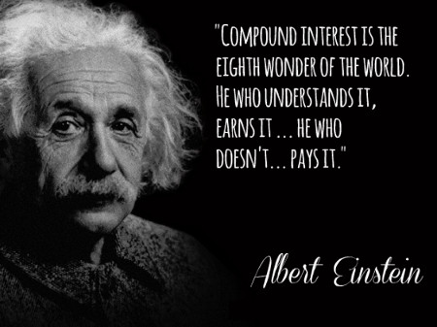
The Power of Compound Interest
“Compound interest is the most powerful force in the universe.”
“Compound interest is the greatest invention the world has ever produced”

Slide 3
Distributions During Life
Before 59½
After 59½ but before RBD
After RBD

Slide 4
Lifetime Required Minimum Distributions
Required Beginning Date – If turned 70½ before 1/1/2020 then April 1 of year following year turn 70½. If did not turn 70½ before 1/1/2020 then April 1 of year following the year turn 72.
Based on prior year December 31 balance
Applicable Divisor – Uniform Life Table or Joint and Last Survivor Table depending on who beneficiary is. New Tables for 2022.
Must be withdrawn by December 31 of current year. Failure to withdraw subject TP to 50% penalty

Slide 5
Effect of Death on RMD
Beneficiary Classification
No Designated Beneficiary – 5 years or Life expectancy of decedent
Spouse – Rollover or Life Expectancy payout – SECURE changed what happens after spouse dies
Designated Beneficiary – Pre-SECURE could create stretch payouts. Death after 2020 – 10-year rule!!

Slide 6
Effect of Death on RMD
Beneficiary Classification – New Under SECURE
Eligible Designated Beneficiary – Allowed to create Stretch IRA (modified in certain situations)
Spouse
Minor Child of the participant – Only the child of the participant
Disabled or Chronically Ill individual
Anyone that is no more than 10 years younger than the participant

Slide 7
Using Trusts as IRA Beneficiary
Reasons to use Trusts – Advantages and Disadvantages
Requirements to make a Trust a “SEE-THROUGH” Trust
Conduit Trusts
Accumulation Trusts
SECURE eliminated many of the benefits of IRA Trust planning

Slide 8
CARES Act Changes
No 10% penalty on Coronavirus-related distributions
3 years to report income
Repayment provision
Waiver of 2020 RMDs – NYS Follows this rule and the rule allowing recontributions prior to 8/31/2020

Slide 9
Potential Changes
Contribution limitations based on account value
Increased RMD for high balance accounts
Elimination of Roth Conversion for high income taxpayers

Slide 10
Neil D. Katz, J.D., LL.M., CPA
Katz Chwat, PC
275 Broadhollow Road
Suite 130
Melville, NY 11747
631-683-8700
neil@katzchwat.com
www.katzchwat.com

