Slide 1
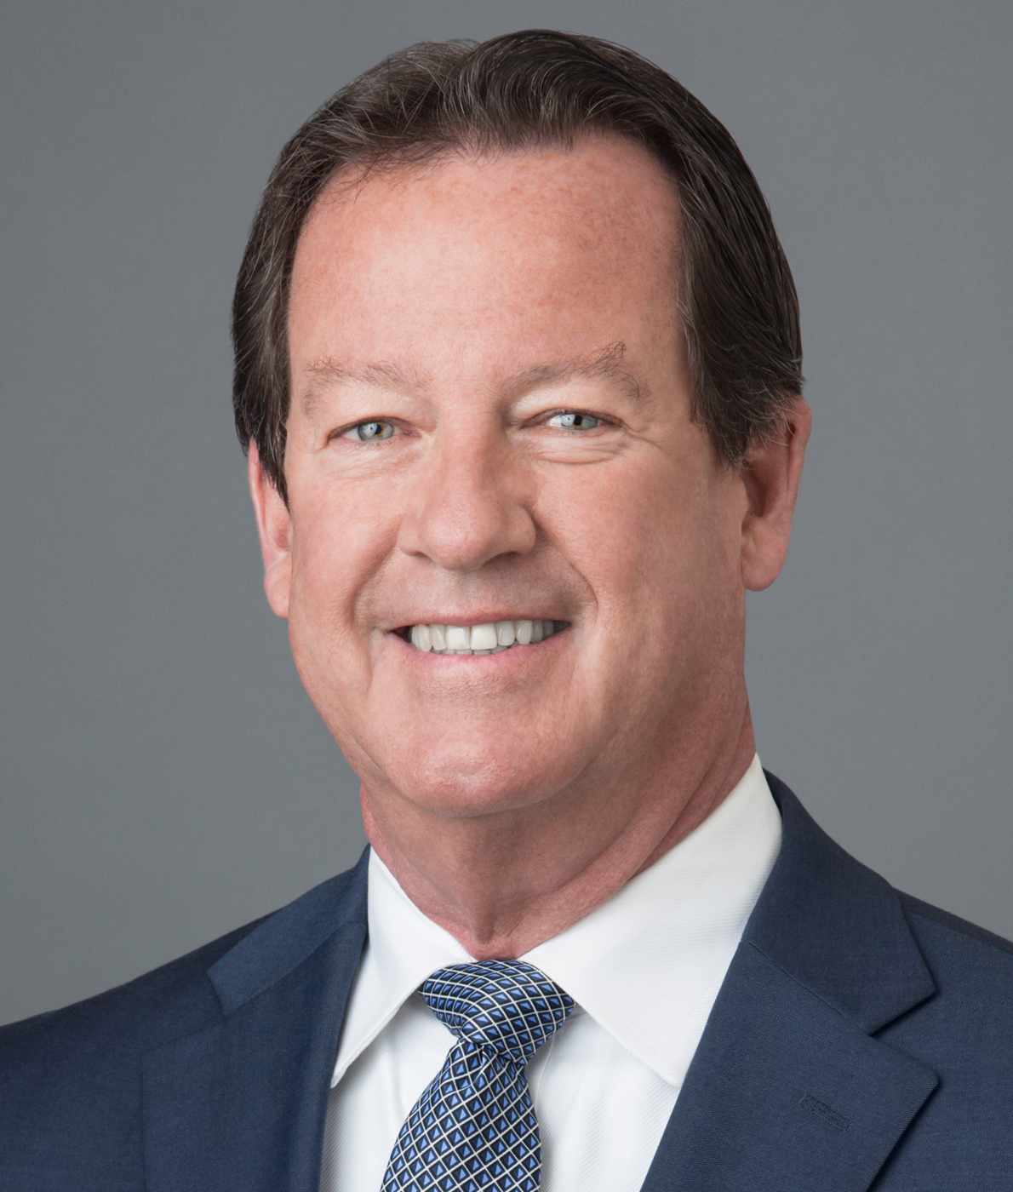
Raymond C. Radigan is a Senior Managing Director and Regional Team Lead with First Republic Trust Company. Mr. Radigan has more than 30 years of experience managing the administration of complex trust and estate accounts and offering comprehensive financial and estate planning advice to high net worth individuals. Prior to joining First Republic, Mr. Radigan managed the trust and financial planning activity for TD Bank and held senior leadership roles at US Bank and U.S. Trust. Mr. Radigan was also a member of the board of directors of the New York Bankers Association. Mr. Radigan is a frequent speaker at estate planning seminars offered by the American Bankers Association, New York State Bar Association, New York Bankers Association, Practicing Law Institute and New York State CPA Society. He is an emeritus member of the board of directors of the Long Island Community Foundation. He is a graduate of St. John’s University School of Law and received his undergraduate degree from Boston College, graduating from the School of Management’s Honors Program. Wealth Management Experience: Since 1988
Ray Radigan
Senior Managing Director, Senior Trust Officer & Regional Lead (212) 453-6259 rradigan@firstrepublic.com
First Republic Private Wealth Management

