Slide 1
How Generational Differences May Impact Estate Planning And Trust Administration
Raymond C. Radigan, J.D.
Senior Managing Director and Regional Team Lead
First Republic Trust Company
The Nassau County Estate Planning Council, Inc.
September 22, 2022

Slide 2
How Generational Differences May Impact Estate Planning And Trust Administration
Section I – Generational Differences
Discuss the general traits and characteristics of each generation – from the Greatest Generation to Generation Alpha.
Section II – Current Trends
Discuss modern social changes and technological advances and how they could affect Estate Planning and Trust Administration in current and future years.
Section III – Estate Planning and Trust Administration Today
Review the evolution of the Trust Document and the Trust Experience over the generations.

Slide 3
SECTION I. GENERATIONAL DIFFERENCES

Slide 4
List of Different Generations (ages in 2022)
1901–1927
The Greatest Generation (95 to 121)
1928–1945
The Silent Generation (77 to 94)
1946–1964
The Baby Boomers
(58 to 76)
1965–1980
Generation X (42 to 57)
1981–1996
Millennials (26 to 41)
1997–2012
Generation Z (10 to 25)
2013–2025
Generation Alpha
(0 to 9)

Slide 5
The Greatest Generation 1901 - 1927
Also known as the GI Generation
Grew up in the Depression
Many fought in World War II
Fought for what was right as opposed to for selfish reasons
Moralistic attitude toward the conflict
Had personal responsibility, duty, honor and faith

Slide 6
Notable Members of the Greatest Generation
John F. Kennedy
Margaret Thatcher
Ronald Reagan
Rosa Parks
Lucille Ball
Mother Theresa
Johnny Carson
Queen Elizabeth II
Jackie Robinson
Nelson Mandela

Slide 7
Notable Living Members of the Greatest Generation
Norman Lear
Angela Lansbury
Dick Van Dyke
Glynis Johns
Jimmy Carter
Rosemary Harris
Anthony Dominick Benedetto
Janis Paige
Melvin Kaminsky
June Lockhart
William Daniels
Gina Lollobrigida

Slide 8
The Silent Generation 1928 - 1945
Also known as the Traditionalists
About 20 million alive in 2022
Smaller population than the Greatest Generation and Baby Boomers
Some were born and lived through the Depression
Grew up expecting a hard life - endured sacrifice
Rebuilt U.S. economy after World War II
Thrifty, respectful, loyal and determined
Tended to marry and have children at younger ages
Silent because they did not protest, accepted government - McCarthy era

Slide 9
Notable Members of the Silent Generation
Paul McCartney
Joan Rivers
Bill Russell
Diana Ross
Willie Mays
Barbra Streisand
Martin Luther King
Julie Andrews
Colin Powell
Anne Frank
Bob Dylan
Elizabeth Montgomery
Muhammed Ali
Billie Jean King

Slide 10
Baby Boomers 1946 - 1964
Booming births after World War II
Preference for structure and discipline – workaholics
Lived through time of prosperity - absence of World War
Country’s wealthiest generation
Retiring later than previous generations
Represents about one-fifth of the population today
Flower children, protest, civil rights, Vietnam, Kennedy and King assassinations and moon landing
Strong interpersonal skills
Had to adapt to advances in technology

Slide 11
Notable Baby Boomers
Bruce Springsteen
Oprah Winfrey
Bill Clinton
Princess Diana
Barack Obama
Charo
Madonna
Bill Gates
Angela Merkel
Michael Jordan
Maureen McCormick
Ray Radigan

Slide 12
Generation X 1965 - 1980
Often children of two working parents - “the daycare generation”
Many value work/life balance - work smart, not hard
Well educated, have appetite for continued learning
Many are part of the Sandwich Generation - raising children and caring for aging parents
Marrying later than previous generations
Passion for charity
Independent, self-sufficient, value autonomy
Comfortable with technology
Lived through many changes - MTV, AIDS, Disco, the fall of the Berlin Wall and the Soviet Union

Slide 13
Notable Members of Generation X
Tiger Woods
J.K. Rowling
Tom Brady
Liz Truss
Elon Musk
Tyra Banks
Charlie Sheen
Jennifer Aniston
Mike Tyson
Tonya Harding

Slide 14
Millennials 1981 - 1996
Just starting careers and family
Motivated by meaningful work
Largest generation in the U.S. workforce
Prefer to collaborate (vs. top down)
Want voices to be heard
Marrying and having children later than previous generations
Move more often - many rent vs. own
Less wealth than previous generations
Digital natives - grew up on the internet
Greater use of digital assets

Slide 15
Notable Millennials
LeBron James
Serena Williams
Mark Zuckerberg
Malala Yousafzai
Stephen Curry
Beyonce
Pete Buttigieg
Natalie Portman
Michael Phelps
Lady Gaga

Slide 16
Generation Z 1997 - 2012
Value social responsibility and diversity
Expect to work with modern technology
Expect to marry later than previous generations
Less likely to be religious
Less time in shopping malls
Less personal interaction
More concerned with climate crisis
More focused on mental health than previous generations
Greater use of digital assets

Slide 17
Notable Members of Generation Z
Trevor Lawrence
Olivia Rodrigo
Billie Eilish
Justin Herbert
Amandla Stenberg
Naomi Osaka
Greta Thunberg

Slide 18
Generation Alpha 2013 - 2025
Youngest generation
More diverse family dynamics
Higher racial diversity
Possible higher economic inequality

Slide 19
Notable Members of Generation Alpha
Prince George
Carter Radigan
Brody Radigan
Dak Zelazny

Slide 20
SECTION II. CURRENTS TRENDS

Slide 21
Historical Life Expectancy Data - US
1950 – 68.14
1960 – 69.84
1970 – 70.78
1980 – 73.70
1990 – 75.19
2000 – 76.75
2010 – 78.49
2020 – 76.99
2021 – 76.60

Slide 22
Interesting Facts About Longevity
Life expectancy has doubled over the past 150 years
Over 85 years old is the fastest growing segment of the population
Women born in South Korea in 2030 are expected to have an average life expectancy of 90 years
One third of babies born in the UK in 2013 are expected to live to 100
The estimated US centenarian population in 1830 was 539 (75,000 today)
The estimated world centenarian population was 95,000 in 1995, 451,000 in 2015 and will grow to 3.7 million in 2050

Slide 23
Facts About Dementia
Worldwide population of dementia is 46 million
By 2050, the expected worldwide population of dementia will be 130 million
A new case of dementia is diagnosed every 3 seconds
Estimated that 5% - 8% of those over 65 have dementia
About 47% of those over 85 have dementia
An estimated 5.8 million Americans have dementia today and an estimate of 14 million will have dementia in 2060

Slide 24
Generations That Report Mental Health Is Good or Excellent (percentage)
Baby Boomer 70%
Generation X 51%
Millennials 56%
Generation Z 45%
Source: American Psychological Association

Slide 25
Other Factors About Mental Illness
Higher levels of stigma surrounding mental illness or depression in older adults
Pandemic has caused a significant increase in depression in all generations
Generation Z has reported higher rates of depression than previous generations but are more likely to seek help
Anxious and depressed youth are increasingly given multiple and powerful pharmaceuticals
37% of Generation Z has sought help from a mental health professional
The right treatment might include therapy and proper medication

Slide 26
Maximum Monthly Social Security Benefit in 2022
AGE
62 $2,364
66 $3,240
70 $4,194

Slide 27
The Current Status of Social Security
More than $1 trillion of Social Security benefits were paid to 65 million recipients in 2020
Since 2010, the system brings in less revenue than pays out in benefits, with the shortfall paid from reserves
Under the current laws, the funds for Social Security will be exhausted in 2034 - if so, benefits must be cut by 22%
Source: 2021 Social Security Trustee’s Report

Slide 28
Possible Ways to Save Social Security
Increase the retirement age
Increase the payroll tax (6.2%)
Increase the cap of income subject to the payroll tax
If the payroll cap is eliminated, it is estimated that this would reduce between one-half to two-thirds of the shortfall

Slide 29
SECTION III. ESTATE PLANNING AND TRUST ADMINISTRATION TODAY

Slide 30
Evolution of the Trust Document
Old
New
Use of interested trustee - family member
Invasions for health, maintenance, education and support
Distributions at age attainments
No power to remove the trustee
Family not involved in trust administration
Use of disinterested trustee
Complete discretion to invade income and principal to maximize asset protection
Fewer outright distributions at age attainments, or trustee’s power to withhold that distribution, if need be
Power to remove the trustee
Family named as co-trustees
More flexibility- trust protector, modification by state law, non judicial settlements, decant
Address ownership of digital assets
Increase use of Directed Trusts
Incentive Trusts

Slide 31
Evolution of the Trust Experience
Old - Negative
Current - Positive
Lack of communication
Beneficiaries not involved
Lackluster investment performance
No power to remove the trustee
Lack of incentives
Lack of flexibility
Proactive communication
Beneficiaries are involved
Better investment performance and more elaborate asset allocation
Power to remove the Trustee
Incentive Trusts
More flexibility

Slide 32
Use of Trusts More Commonplace
Lifetime gifts - take advantage of the Federal gift tax exemption
Transfers at death
Retain more control and maximize asset protection
Provide incentives
Succession planning
Plan for possible future incapacity
Avoid probate
Increase in depression
Special needs

Slide 33
Incorporating Flexibility into the Estate Plan
Name alternate beneficiaries if the primary beneficiaries are deceased
Appoint successor fiduciaries
Empower beneficiaries to make changes - power of appointment, power to replace the Trustee
Empower Trustees to make changes
Designate a Trust Protector
Consider decanting, when appropriate
Give the Grantor the power to substitute assets
New York does not have a statute recognizing the Trust Protector or the Non-Judicial Settlement Agreement.

Slide 34
Using a General Power of Appointment to Obtain a Step Up in Basis - Example
A Trust is established and includes a farm that was purchased for $200,000.
The farm is now worth $3 million due to potential development rights.
X, the beneficiary, has a general power of appointment over the farm property.
X owns other assets worth $2 million and dies in 2022.
The farm is included in X’s estate , even though X did not exercise the power of appointment and the farm goes to others pursuant to the terms of the Trust.
Since the total value of X’s estate is $5 million, the estate will not owe any New York or Federal estate taxes.
The new cost basis of the farm is now $3 million.

Slide 35
Using a Limited Power of Appointment to Change the Distribution of Trust Assets - Example
Grantor and spouse have two children.
Grantor dies and creates a Trust for the benefit of the surviving spouse.
The surviving spouse has a limited power of appointment where at death, he or she has the power to appoint the remaining property, outright or in further trust, for either of their two children. Otherwise, the trust assets will be divided equally and in further trust for each of their two children.
Since the creation of the Trust, the first child has become extremely wealthy while the second child is working at a charitable organization.
The surviving spouse may decide to direct that all or a larger portion of the remaining assets be held in trust for the benefit of the second child.

Slide 36
Potential Powers to Trust Protectors
Modify the agreement
Remove and replace Trustees
Veto, direct, change or consent to distributions
Terminate the Trust
Change situs and governing law
Modify powers of appointment

Slide 37
Drafting a Trust to Plan For Possible Future Incapacity
Mechanism to remove the Grantor as Trustee if incompetent
Express preference for home care
Providing the power to provide care and support
Trustee’s power to retain counsel and physician
Address medical records – access and release of information, when appropriate
Provide for travel, leisure and social activities
Provide for gifts to family members and charities
Helps protect against financial exploitation

Slide 38
Estate Planning for Older Generations Issues to Consider
Delegate financial and health care decisions
Plan for long term care
Plan for possible future loss of capacity
Consider the benefits of a lifetime Trust to minimize future transfer taxes
Retirement planning
Consider the benefits of a Trust for asset transfers at death

Slide 39
Estate Planning for the Sandwich Generation Issues to Consider
Primarily consists of Generation X and Millennials
Additional estate planning concerns include:
Designate Guardians for children
Create Trusts for children if both parents are deceased
Establish 529 plan for children’s education
Plan ahead for parent’s long-term care
Consider cash gifts to parents
Consider buying your parent’s house
Set up parent’s power of attorney and health care proxy
Obtain HIPAA authorization

Slide 40
Estate Planning for Younger Generations Issues to Consider
Designate Guardians for children
Wealth creation planning
Life insurance planning
Addressing potential mental health concerns
Retirement planning
Delegating financial and health care decisions
Asset transfers at death - consider the benefits of a Trust

Slide 41
How Generational Differences May Impact Estate Planning And Trust Administration
Section I – Generational Differences
Discuss the general traits and characteristics of each generation – from the Greatest Generation to Generation Alpha.
Section II – Current Trends
Discuss modern social changes and technological advances and how they could affect Estate Planning and Trust Administration in current and future years.
Section III – Estate Planning and Trust Administration Today
Review the evolution of the Trust Document and the Trust Experience over the generations.

Slide 42
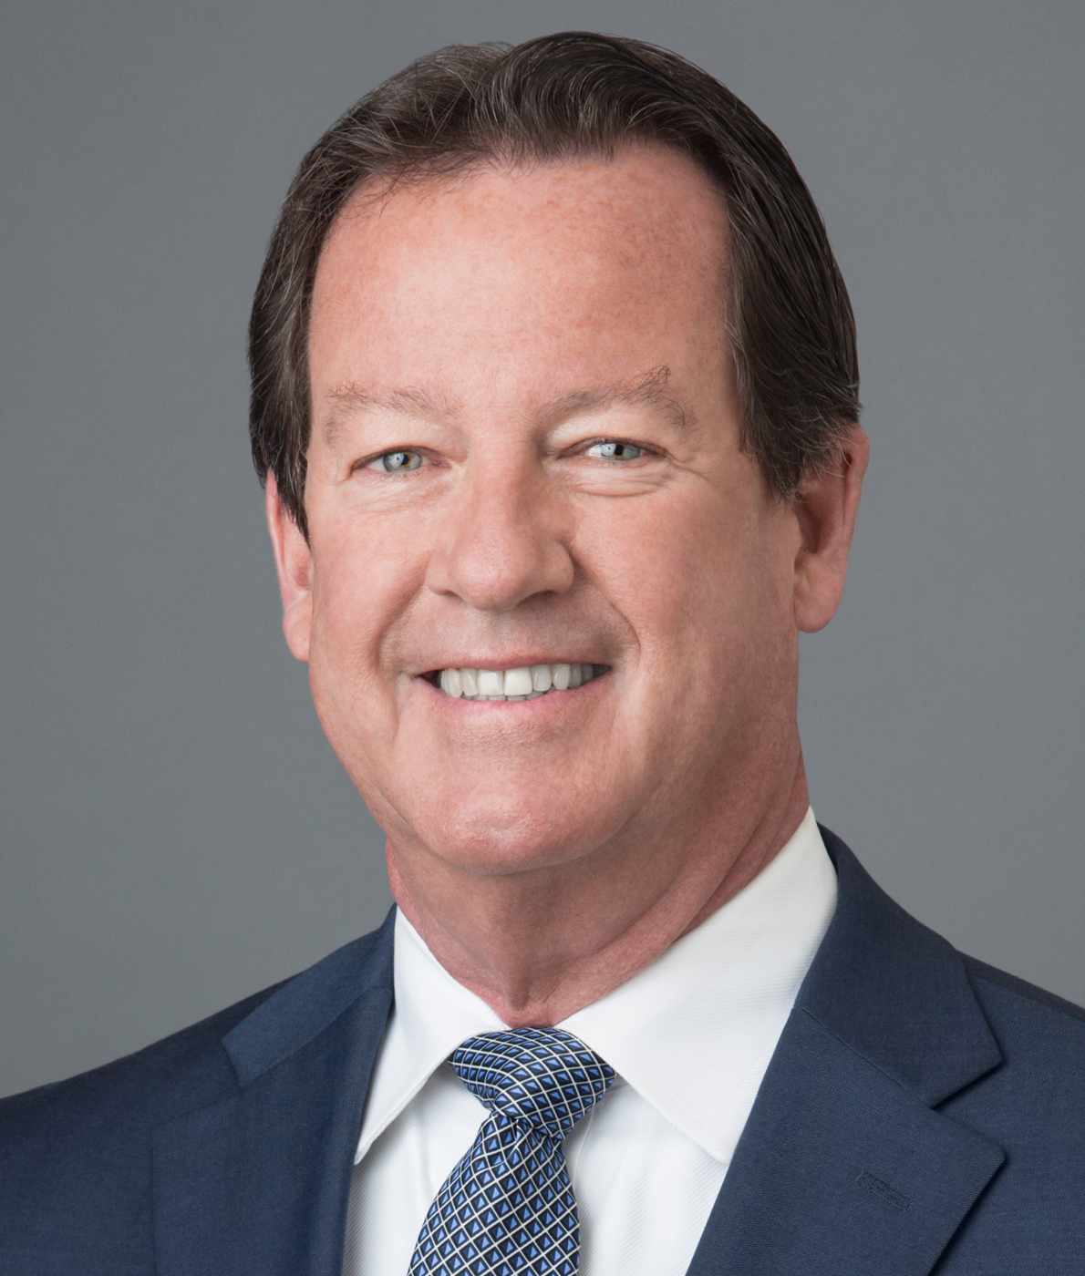
Raymond C. Radigan is a Senior Managing Director and Regional Team Lead with First Republic Trust Company. Mr. Radigan has more than 30 years of experience managing the administration of complex trust and estate accounts and offering comprehensive financial and estate planning advice to high net worth individuals. Prior to joining First Republic, Mr. Radigan managed the trust and financial planning activity for TD Bank and held senior leadership roles at US Bank and U.S. Trust. Mr. Radigan was also a member of the board of directors of the New York Bankers Association. Mr. Radigan is a frequent speaker at estate planning seminars offered by the American Bankers Association, New York State Bar Association, New York Bankers Association, Practicing Law Institute and New York State CPA Society. He is an emeritus member of the board of directors of the Long Island Community Foundation. He is a graduate of St. John’s University School of Law and received his undergraduate degree from Boston College, graduating from the School of Management’s Honors Program. Wealth Management Experience: Since 1988
Ray Radigan
Senior Managing Director, Senior Trust Officer & Regional Lead (212) 453-6259 rradigan@firstrepublic.com
First Republic Private Wealth Management

